Slide 1
T-Test: Comparing Two Means

Slide 2
“Experiments”
The simplest is one with only one independent variable that is manipulated in only two ways and only one outcome is measured.
Do conservatives and liberals differ in how they discipline their children?
Can measure discipline using a 0-100 severity scale
Then ask: do the means (of discipline) differ between the two groups?
If they don’t (or difference is small), ca assume that difference is b/c of sampling error, or that no difference exists between the groups in the population, and fail to reject the null hypothesis
If they do (and difference is large), can assume difference is not b/c of sampling error, and can reject the null hypothesis of no mean difference
Can be analyzed with a t-test

Slide 3
T-Test: Reminder
IV: categorical/discrete (e.g. nominal, ordinal)
Only two groups/samples (or time-points) compared
DV: continuous (e.g. interval-ratio)

Slide 4
Two Types of T-test
Independent Samples t-test
Compares two means based on independent data
Data from different groups of people
Paired (Dependent) Samples t-test
Compares two means based on related data
Data from the same people measured at different times.

Slide 5

The Independent Samples t-test
Null Hypothesis (H₀): There is no mean difference in the dependent variable between group 1 and group 2 in the population
$µ1$ $=$ $µ2$
Research Hypothesis (H₁): There is a mean difference in the dependent variable between group 1 and group 2 in the population
$µ1$ $≠$ $µ2$

Slide 6
Rationale for the t-test
Two samples of data are collected and the sample means calculated. These means might differ by either a little or a lot.
If the samples come from the same population, we expect their means to be roughly equal. We would expect large sample mean differences to occur infrequently.

Slide 7
Rationale for the t-test
Compare difference between the sample means to the difference between the sample means that we would expect to obtain if there were no effect (i.e. if the null hypothesis were true).
Use standard error to gauge variability between sample means. If the difference between the samples is larger than expected based on standard error then:
There is no effect and sample means in our population fluctuate a lot and we have, by chance, collected two samples that are atypical of the population from which they came.
The two samples come from different populations but are typical of their respective population. The difference between samples is a genuine difference between the samples (and so the null hypothesis is incorrect).
As the observed difference between the sample means gets larger, the more confident we become that the null hypothesis should be rejected.

Slide 8
Rationale for the t-test
t | = | observed difference between sample means | − | expected difference between population means (if null hypothesis is true)
 |  | estimate of the standard error of the difference between means

Slide 9
Assumptions of the t-test
Both t-tests are parametric and based on the normal distribution and therefore assume:
The sampling distribution is normally distributed.
This means that the sampling distribution of the differences between means (or, for the paired t-test, between the same person’s score 1 and score 2) should be normal, not the scores themselves.
Data are measured at least at the interval level.
The independent t-test (specifically) assumes:
Variances in these populations are roughly equal (homogeneity of variance).
Scores in different treatment conditions are independent (because they come from different people).

Slide 10
The Independent Samples T-test (Obtained)
1 2
Notes:
Where s12 and s22 are the estimated variances for each population (so the sample variances).

Slide 11
Independent t-test Example
Are invisible people mischievous?
Manipulation/Group
12 participants were given an invisibility cloak.
12 participants were not given an invisibility cloak.
Outcome/Dependent variable
Measured how many mischievous acts participants performed in a week.

Slide 12
Calculate t-test for Mischievousness by Cloak Use
Open Invisibility.sav
Analyze -> Compare Means -> Independent Samples T-Test
Grouping Variable (IV)
Type the values associated with the two groups
Test Variable (DV)

Slide 13
Calculating t
To see if our obtained (hand calculated) t value is statistically significant, we have to compare it to a critical or table t value
To do so, we need to know
degrees of freedom for our t
Our alpha level (a = .05)

Slide 14
Degrees of Freedom
Since we are estimating population variance from our two samples (in the equation) we lose two degrees of freedom
df = n₁ + n₂ - 2

Slide 15
Calculating t
We use our obtained t (t), and our degrees of freedom (df) to look up the significance level in Appendix A.2 (page 893).
Using our df, we follow the table down that row and stop when we reach a value greater than our obtained t. Then go back one column.
If there is no value greater than your obtained value, use the final column.
If there is no value less than your obtained value, your p-value is above the accepted .05, so non-significant
Go up to that column, and report that value as your p-value (significance level).

Slide 16
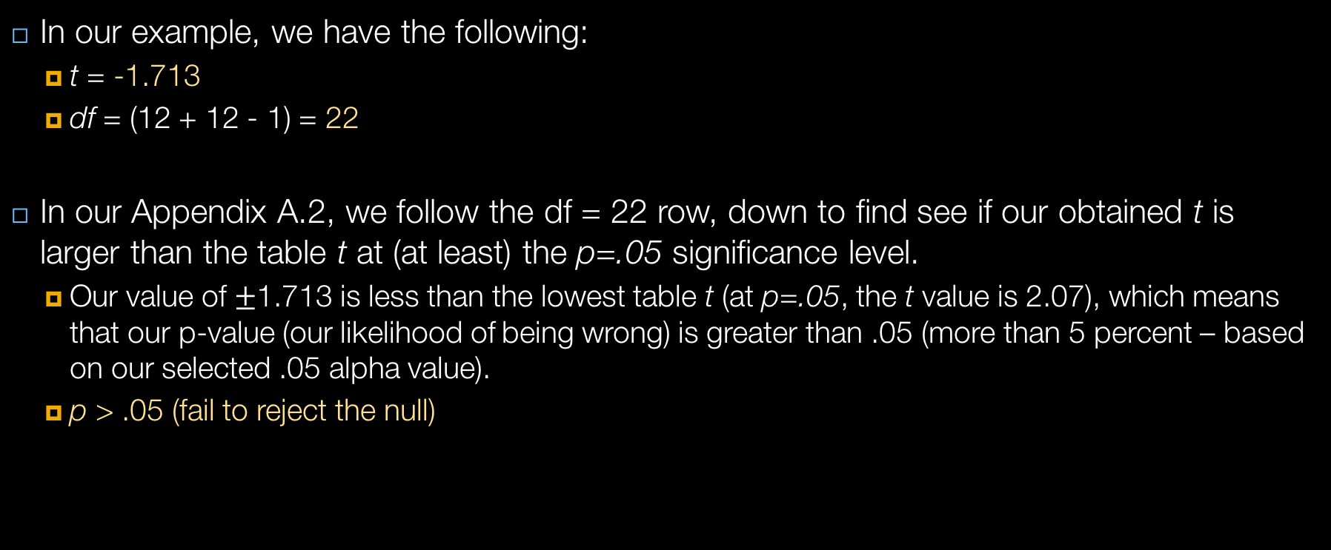
Calculating t
In our example, we have the following:
t = -1.713
df = (12 + 12 - 1) = 22
In our Appendix A.2, we follow the df = 22 row, down to find see if our obtained t is larger than the table t at (at least) the p=.05 significance level.
Our value of $±$1.713 is less than the lowest table t (at p=.05, the t value is 2.07), which means that our p-value (our likelihood of being wrong) is greater than .05 (more than 5 percent – based on our selected .05 alpha value).
p > .05 (fail to reject the null)

Slide 17
Reporting t
Report
The test used
If you reject or fail to reject the null hypothesis
The variables used in the analysis
The degrees of freedom, calculated value of the test, and p-value
t(df) = t value, p-value
“Using an independent-samples t-test, I fail to reject the null hypothesis that there is no mean difference between mean mischievousness between cloak and non-cloak wearers, in the population, t(22) = -1.713, p > .05.
On average, participants given a cloak of invisibility engaged in similar amounts of mischief (M = 5, SD = 1.651), than those not given a cloak (M = 3.75, SD = 1.913).”

Slide 18
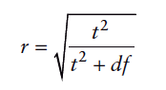
Calculating the Effect Size

Slide 19
ICE #3: Attractiveness and Mean Number of Sons
Open Gelman & Weakliem (2009).sav
Do attractive people have higher mean number of kids?
Run a t-test to find out
Fully and correctly report your t-test value (including the t-value, df, and significance level)

Slide 20
The Paired Samples t-test
Notes:
D is diff in sample means, population diff is mu which is 0 expected, over SD, and size of sample

Slide 21
Paired Samples t-test Example
Are invisible people mischievous?
24 Participants
Manipulation
Placed participants in an enclosed community riddled with hidden cameras.
For first week participants normal behaviour was observed.
For the second week, participants were given an invisibility cloak.
Outcome
measured how many mischievous acts participants performed in week 1 and week 2.

Slide 22
Paired Samples t-test Output

Slide 23
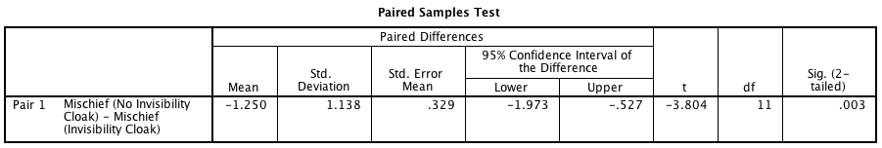
Paired Samples t-test Output Continued

Slide 24
Reporting the paired-samples t-test
On average, participants given a cloak of invisibility engaged in more acts of mischief (M = 5, SE = 0.48), than those not given a cloak (M = 3.75, SE = 0.55). This difference, −1.25, BCa 95% CI [−1.67, −0.83], was significant t(11) = −3.80, p = .003 and represented a medium-sized effect d = .65.

